Slide 1
Course : COMP8043 – Machine Learning
Period : September 2020
Clustering and Mixture Models
Session 08
KDS – Amalia Zahra, S.Kom., Ph.D.

Slide 2
Learning Outcomes
After the completion of this session, students are expected to achieve the following learning outcomes:
LO2: Describe the characteristics of various Machine Learning algorithms and understand how each of them works, including the mathematical principles underlying the algorithms.
LO3: Apply relevant Machine Learning algorithms according to individual cases/problems and perform evaluation.
LO4: Analyze the results obtained from Machine Learning experiments from several perspectives.

Slide 3
Session Outcomes
By completing this session, you will be able to:
Describe the concept of cluster analysis
Describe various similarity metrics and implement them
Describe different kinds of clusters
Summarize steps in k-Means Clustering
Summarize steps in Fuzzy C-Mean Clustering (Fuzzy Clustering)
Summarize steps in Mixture Model Clustering
Summarize steps in Expectation-Maximization (EM) Algorithm

Slide 4
Topics
Cluster Analysis
Similarity Measures and Data Types
Kinds of Cluster
Clustering Method 1: Partitioning
  k-Means Clustering
Clustering Method 2: Hierarchical
Fuzzy C-Mean (FCM) Clustering
Mixture Model Clustering
Expectation-Maximization (EM) Algorithm

Slide 5
CLUSTER ANALYSIS

Slide 6

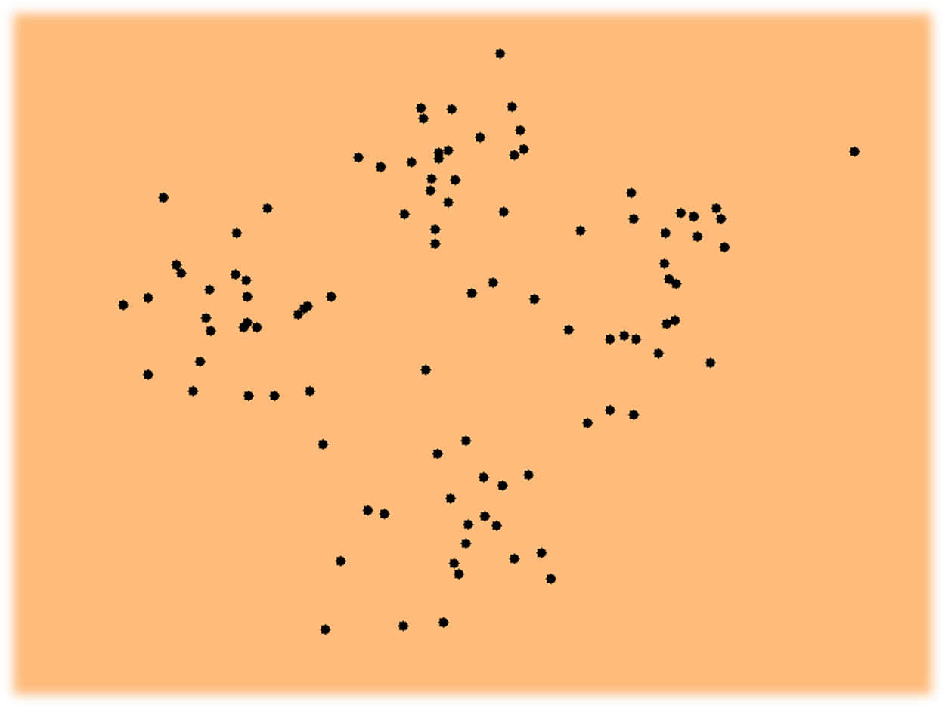
http://shabal.in/visuals/kmeans/4.html

Slide 7
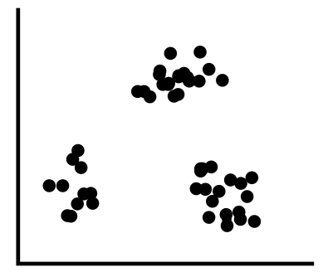
Cluster Analysis
Cluster analysis or clustering is the task of splitting points into groups (or clusters)
Points in one cluster are similar in some senses to one another than to points in other cluster
Clustering is unsupervised classification: no predefined classes or label are required
Sepal length
Sepal width
Petal length
Petal width
Type
1
5.1
3.5
1.4
0.2
Iris setosa
2
4.9
3.0
1.4
0.2
Iris setosa
…
51
7.0
3.2
4.7
1.4
Iris versicolor
52
6.4
3.2
4.5
1.5
Iris versicolor
…
101
6.3
3.3
6.0
2.5
Iris virginica
102
5.8
2.7
5.1
1.9
Iris virginica
…

Slide 8
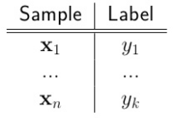
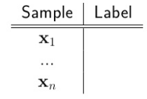
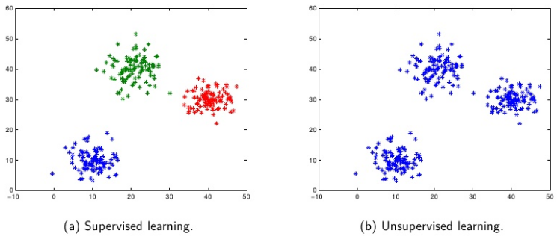
Cluster Analysis vs Classification
Clustering do not predict any value, but focus on descriptive model that describes categories
https://www.slideshare.net/phvu/kmeans-em-and-mixture-models

Slide 9
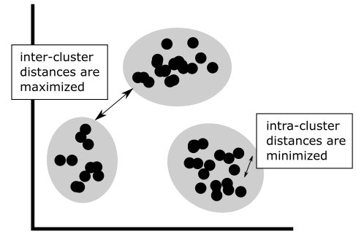
Cluster Analysis
Clustering do not predict any value, but focus on descriptive model that describes:
    Intrinsic structure
    Interconnectedness of the points
A good clustering method ensures that inter-cluster distances are maximized, and intra-cluster distances are minimized.

Slide 10
Cluster can be Ambiguous
How many clusters?
Six Clusters
Two Clusters
Four Clusters

Slide 11
Usage in Business
Tower location - a telecommunication company needs to place its towers in a region. The location of these towers can be found by clustering so that all users receive signal.
SIM keliling – National police wants to provide mobile service vans for driving license extension. The vans can be located/deployed using cluster analysis based on population.
Market segmentation – Help marketers to discover distinct customer groups, and then develop different types of marketing programs to each group.

Slide 12
SIMILARITY MEASURES AND DATA TYPES

Slide 13
Similarity Measures
Points are put into different clusters based on a similarity measure, expressed in terms of distance function d(X,Y).
The definitions of distance functions are different depending on types of data:
    interval-scaled variables
    Boolean/binary variables
    categorical, ordinal and ratio variables

Slide 14


Interval-Valued variables
Standardize data
  Calculate the mean absolute deviation:
  where
  Calculate the standardized measurement (z-score)
Using mean absolute deviation is more robust than using standard deviation.

Slide 15


Similarity Metric
Distances are normally used to measure the similarity or dissimilarity between two data points
Some popular ones include: Minkowski distance:
  where i = (x_{i1}, x_{i2}, …, x_{ip}) and j = (x_{j1}, x_{j2}, …, x_{jp}) are two p-dimensional data points, and q is a positive integer.
If q = 1, d is Manhattan distance:

Slide 16

Similarity Metric
If q = 2, d is Euclidean distance:
  Properties:
    d(i,j) ≥ 0
    d(i,i) = 0
    d(i,j) = d(j,i)
    d(i,j) ≤ d(i,k) + d(k,j)
Also, one can use weighted distance, parametric Pearson product moment correlation, or other dissimilarity measures.

Slide 17



Binary Variables
A contingency table for binary data
Simple matching coefficient (invariant, if the binary variable is symmetric):
Jaccard coefficient (noninvariant if the binary variable is asymmetric):
Object j
Object i

Slide 18


Similarity Metric
Example
  gender is a symmetric attribute
  the remaining attributes are asymmetric binary
  let the values Y and P be set to 1, and the value N be set to 0

Slide 19

Nominal Variables
A generalization of the binary variable in that it can take more than 2 states, e.g., red, yellow, blue, green
Method 1: Simple matching
  m: # of matches, p: total # of variables
Method 2: use a large number of binary variables
  creating a new binary variable for each of the M nominal states.

Slide 20


Ordinal Variables
An ordinal variable can be discrete or continuous.
Order is important, e.g., rank.
Can be treated like interval-scaled:
  replace x_{if} by their rank
  map the range of each variable onto [0, 1] by replacing i-th object in the f-th variable by:
  compute the dissimilarity using methods for interval-scaled variables.

Slide 21
KINDS OF CLUSTER

Slide 22
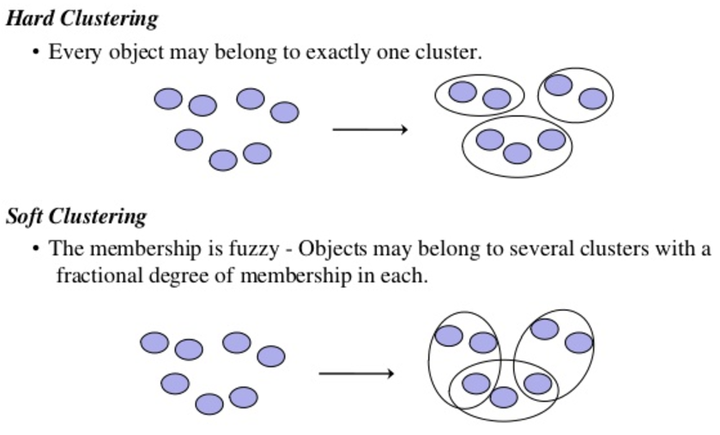

Kinds of Cluster

Slide 23
Cluster Models
Model Centroid: Clusters are represented by a central vector, which may not necessarily be a member of the data set. Algorithms include K-Means, FCM.
Model Connectivity: This model connects “data samples" to form "clusters" based on their distance. Algorithms include Aglomeratif dan Divisive.

Slide 24
Cluster Models
Model Distribution: Clusters are defined as data samples belonging most likely to the same distribution. Methods include Gaussian Mixture Models which is trained using Expectation-Maximization.
Model Density: Clusters are defined as areas of higher density than the remainder of the data set. Methods include DBSCAN and OPTICS.

Slide 25
CLUSTERING METHOD 1: PARTITIONING

Slide 26
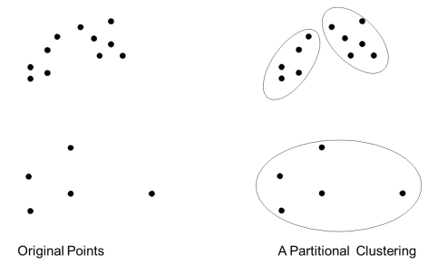
Partitioning Method
The simplest cluster analysis is partitioning.
Partitional Clustering
  A division of data objects into a set of k clusters, such that each data object is in exactly within one cluster.
  The goal is to find a partition of k clusters that optimizes a partitioning criterion.
  There are two partitioning methods emerge: k-means and k-medoids.

Slide 27

k-Means Clustering
k-means use centroid (center point) to represent each cluster.
Number of clusters, k, must be specified.
Given a set of data objects (x₁, x₂, …, x_{n}), where each object is a d-dimensional real vector, k-means clustering aims to split these objects into k (≤ n) clusters S = {S₁, S₂, …, S_{k}}.
Formally, the objective is to minimize the sum of a distance (e.g. Euclidean distance) of objects to their respective centroid:
where μ_{i} is the mean of points (centroid) in cluster S_{i}.

Slide 28
k-Means Algorithm
Given a number of clusters k, k-means works as follow:
Randomly select k points as the initial centroids.
repeat
  Form k clusters by (re)assigning all points to the closest centroid.
  Recompute the centroid of each cluster.
until the centroids converge.

Slide 29

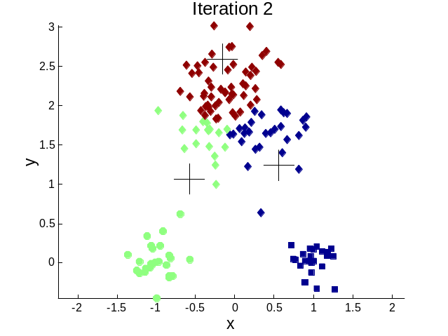



Importance of Choosing Initial Centroid

Slide 30



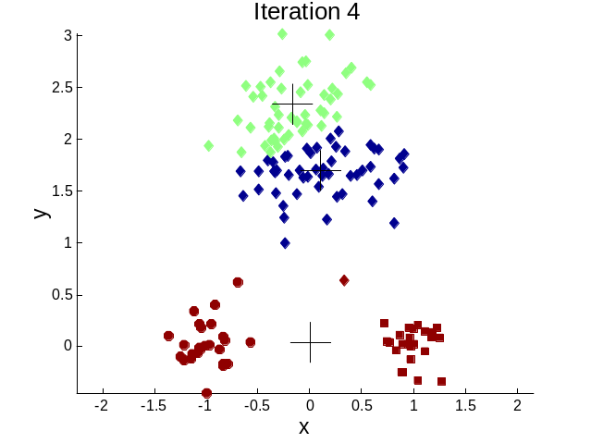

Importance of Choosing Initial Centroid

Slide 31
Dealing with Initialization
Problem:
  Choosing wrong initial centroid can lead to bad results.
Solution:
  Do multiple runs and select the clustering with the smallest error.
  Select original set of points by methods other than random e.g. pick the most distant (from each other) points as cluster centers (K-means++ algorithm).

Slide 32
Note on k-Means
Besides Euclidean distance, there are other distance measures such as cosine similarity, correlation, Manhattan distance.
In general, it’s a fast and efficient algorithm, with complexity O( n * k * I * d ), where n = number of points, k = number of clusters, I = number of iterations, d = dimensionality.
k-Means has limitation when clusters are of different size, density, non-globular shapes.
k-Means has problems when data contains outliers. All points are assigned to cluster between if they do not belong to any cluster. The anomalous points pull the cluster centroid towards them, making it harder to detect them as outliers.

Slide 33
Pre-processing and Post-processing
Pre-processing
  Normalize the data
  Eliminate outliers
Post-processing
  Eliminate small clusters that may represent outliers
  Split ‘loose’ clusters, i.e., clusters with relatively high SSE
  Merge clusters that are ‘close’ and that have relatively low SSE
  Can use these steps during the clustering process
    ISODATA

Slide 34


Limitations of k-Means: Different Size
Original Points
k-Means (3 Clusters)

Slide 35


Limitations of k-Means: Different Density
Original Points
k-Means (3 Clusters)

Slide 36


Limitations of k-Means: Non-globular Shapes
Original Points
k-Means (2 Clusters)

Slide 37
Variations
k-medoids: Similar problem definition as in k-Means, but the centroid of the cluster is defined to be one of the points in the cluster (the medoid).
k-centers: Similar problem definition as in k-Means, but the goal now is to minimize the maximum diameter of the clusters (diameter of a cluster is maximum distance between any two points in the cluster).

Slide 38
CLUSTERING METHOD 2: HIERARCHICAL

Slide 39
Hierarchical Method
Two main types of hierarchical clustering:
  Agglomerative:
    Start with the points as individual clusters
    At each step, merge the closest pair of clusters until only one cluster (or k clusters) left
  Divisive:
    Start with one, all-inclusive cluster
    At each step, split a cluster until each cluster contains a point (or there are k clusters)
Traditional hierarchical algorithms use a similarity or distance matrix
  Merge or split one cluster at a time

Slide 40


Hierarchical Method
Produces a set of nested clusters organized as a hierarchical tree.
Can be visualized as a dendrogram.
  A tree like diagram that records the sequences of merges or splits.

Slide 41
Strengths of Hierarchical Clustering
Do not have to assume any particular number of clusters.
  Any desired number of clusters can be obtained by ‘cutting’ the dendogram at the proper level.
They may correspond to meaningful taxonomies.
  Example in biological sciences (e.g., animal kingdom, phylogeny reconstruction, …)

Slide 42
Agglomerative Clustering Algorithm
More popular hierarchical clustering technique
Basic algorithm is straightforward
  Compute the proximity matrix
  Let each data point be a cluster
  Repeat
  Merge the two closest clusters
  Update the proximity matrix
  Until only a single cluster remains
Key operation is the computation of the proximity of two clusters
  Different approaches to defining the distance between clusters distinguish the different algorithms

Slide 43
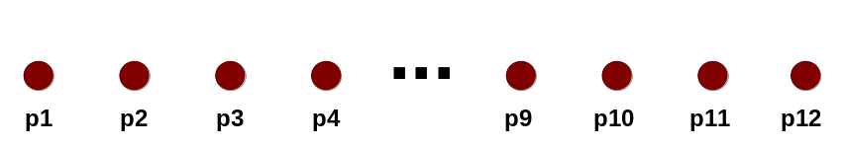
Starting Situation
Start with clusters of individual points and a proximity matrix
p1
p2
p3
p4
p5
. . .
p1
p2
p3
p4
p5
.
.
.
Proximity Matrix

Slide 44
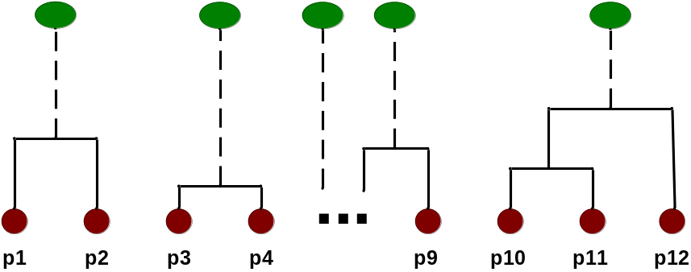
Intermediate Situation
After some merging steps, we have some clusters
C1
C2
C3
C4
C5
C1
C2
C3
C3
C4
C4
C5
C1
Proximity Matrix
C2
C5

Slide 45

Intermediate Situation
We want to merge the two closest clusters (C2 and C5) and update the proximity matrix.
C1
C2
C3
C4
C5
C1
C2
C3
C3
C4
C4
C5
Proximity Matrix
C1
C2
C5

Slide 46

After Merging
The question is “How do we update the proximity matrix?”
C2 U C5
C1
C3
C4
C1
?
C2 U C5
? ? ? ?
C3
C3
?
C4
C4
?
C1
Proximity Matrix
C2 U C5

Slide 47
FUZZY C-MEANS
(FUZZY CLUSTERING)

Slide 48
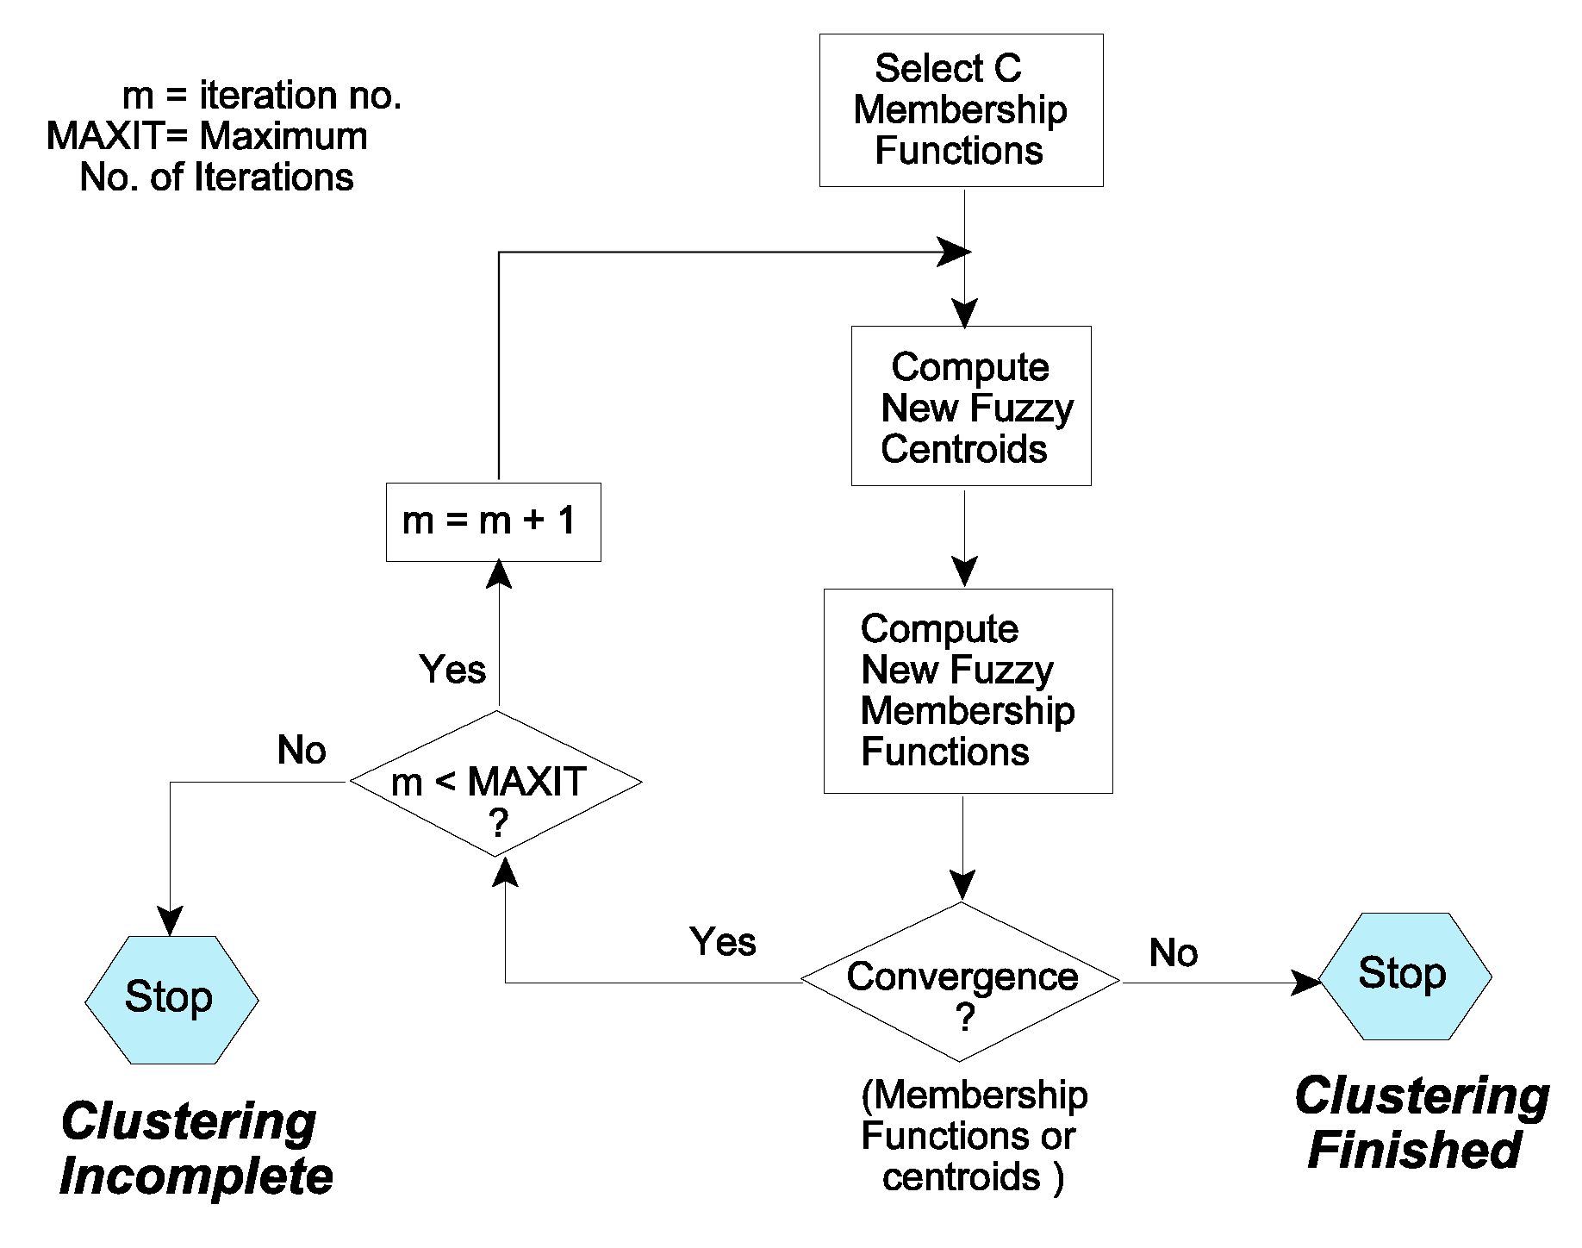
Flow of Fuzzy C-Means
No
Yes

Slide 49
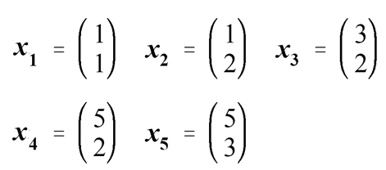
An Example of FCM
Given the following set of data vectors
Perform a Fuzzy Clustering of the data using Fuzzy C-Means Algorithm to obtain two fuzzy clusters. Try several initial conditions. Is the result unique? (use MAXIT=1000)
Using the results of (a) give a crisp clustering of the data.
Repeat (a) and (b) for three Fuzzy Clusters.

Slide 50
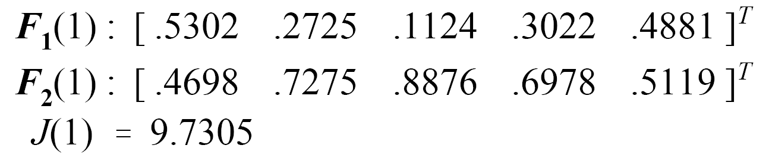
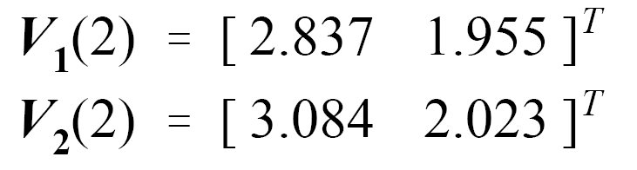
Solution for Two Clusters
Fuzzy cluster membership functions randomly initialized:
Calculation of Fuzzy Centroids:

Slide 51
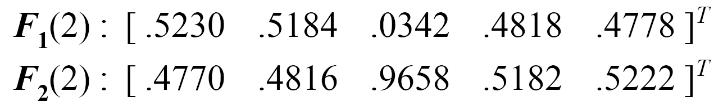

Solution for Two Clusters
Calculation of New Membership Functions
Calculation of similarity distance between items and centroid
Update new membership matrix
Not the same as preceding iteration Membership function (No convergence)
Number of iterations not greater than 1000 therefore the iterations continue.

Slide 52
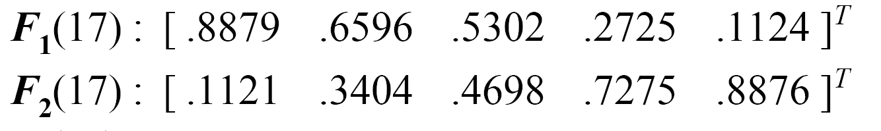

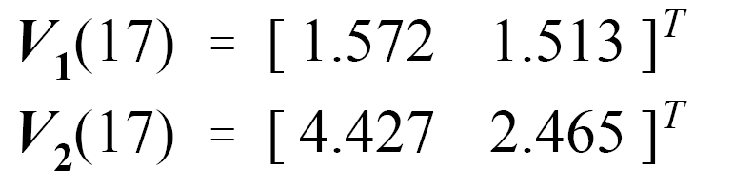
Solution for Two Clusters
Results Converge at Iteration 17
Cluster membership Functions
Performance Measure
Cluster Centroids

Slide 53
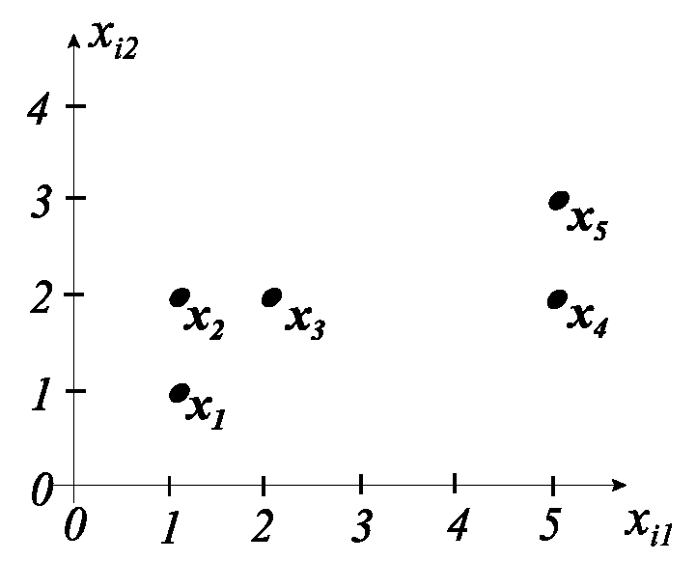
Final Cluster Membership Functions
Cl₁ :
Cl₂ :

Slide 54
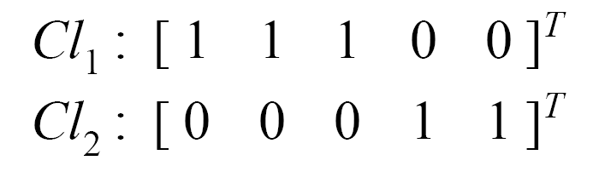
Solution of Hard Clustering
Cl₁ :
Cl₂ :
Crisp Membership functions
Set Assignment
Cl₁ = { x₁, x₂, x₃ } Cl₂ = { x₄ , x₅ }

Slide 55
Summary of FCM
Fuzzy Clustering can be used to produce Hard Clustering.
The larger the value of m the fuzzier the clusters.
The Fuzzy algorithm is relatively stable and usually converges in a reasonable number of iterations.
The Fuzzy algorithm is relatively insensitive to initial conditions.

Slide 56
MIXTURE MODEL CLUSTERING

Slide 57
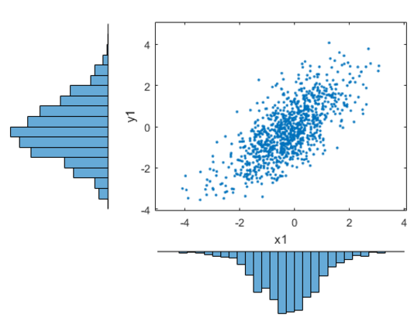
Mixture Model
Assume that there is a model that describes data, and we will try to find the parameter of the model that best fits the data.
https://www.mathworks.com/examples/product-family/matlab

Slide 58
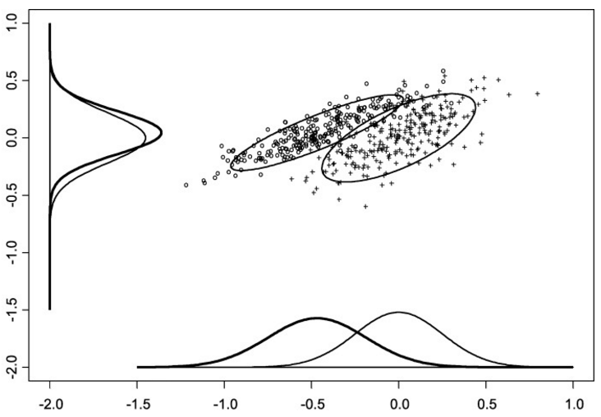
Mixture Model
In most cases, a single distribution is not good enough to describe all data points: different parts of the data follow a different distribution.
We need a mixture model.
Different distributions
correspond to different
clusters in the data.
https://www.researchgate.net/figure/8068989_fig1_Figure-1-Bivariate-distribution-of-logMoM-PAPP-A-in-the-first-trimester-horizontal

Slide 59
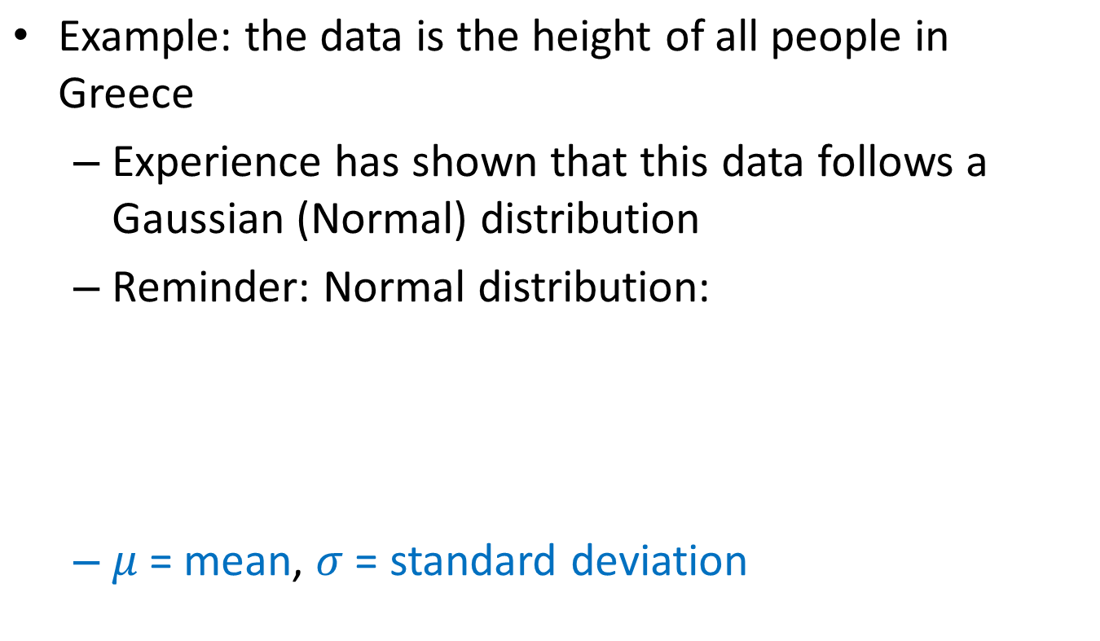
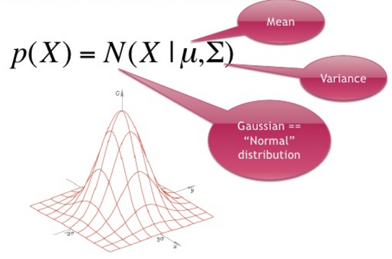
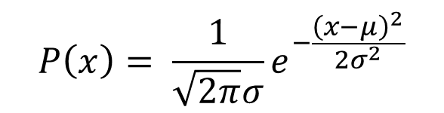
Gaussian Distribution

Slide 60
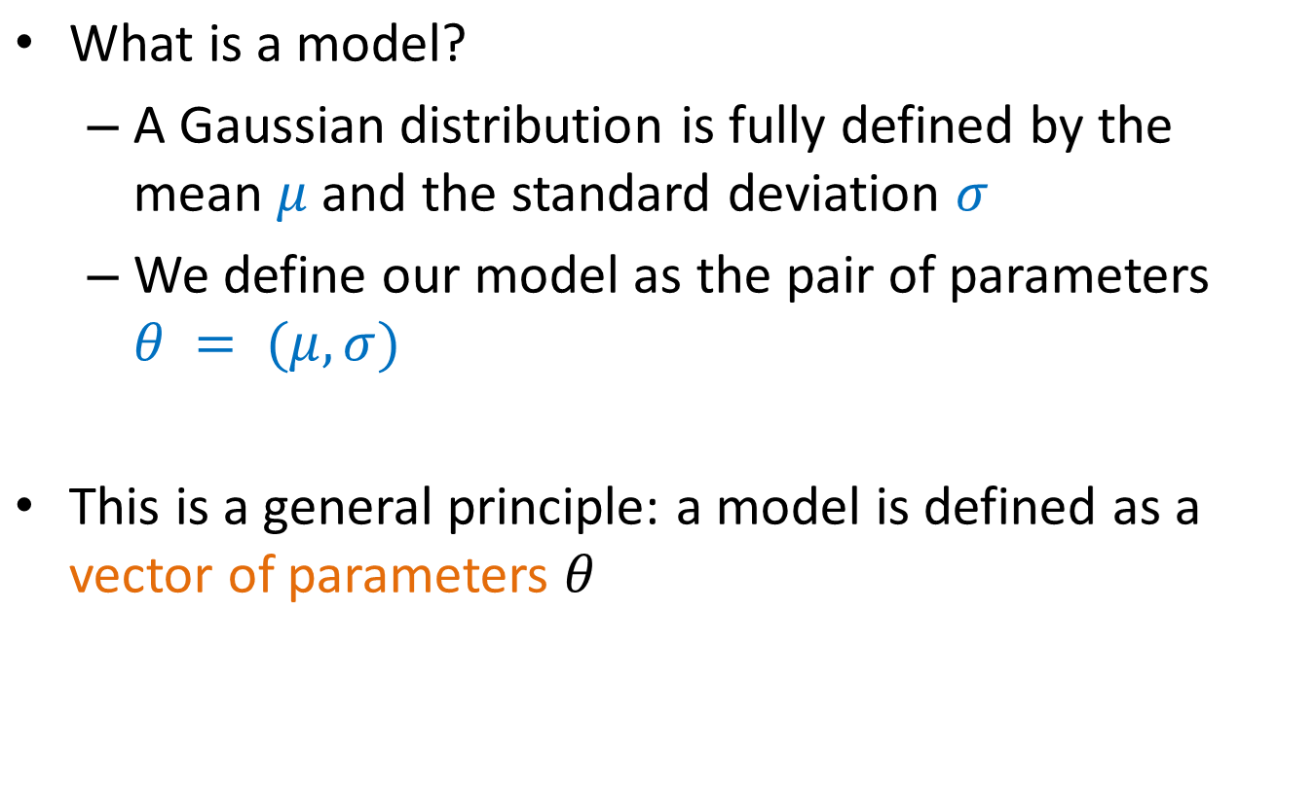
Gaussian Model

Slide 61
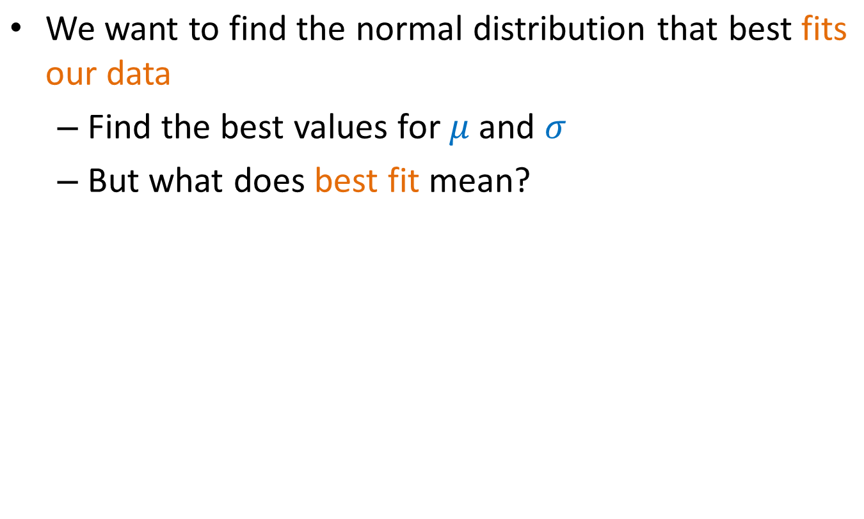
Fitting the Model

Slide 62
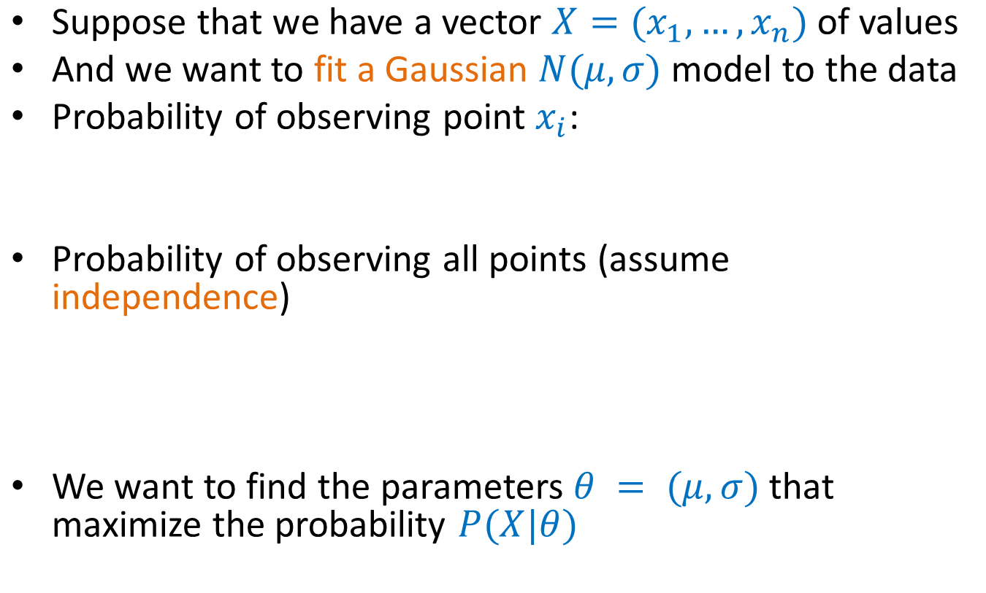
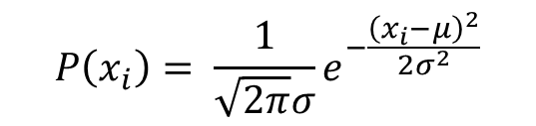
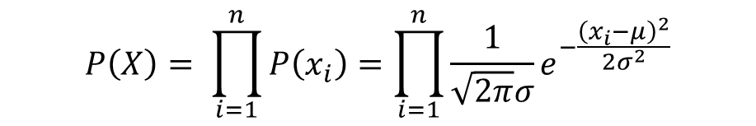
Maximum Likelihood Estimation (MLE)

Slide 63
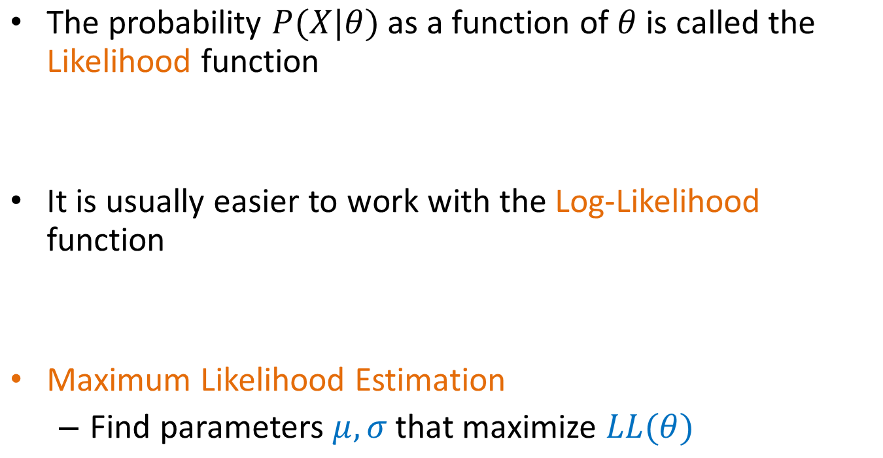

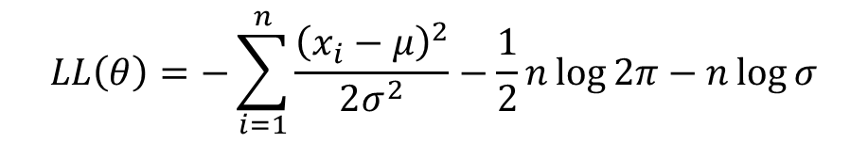
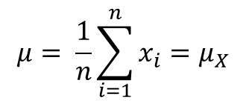
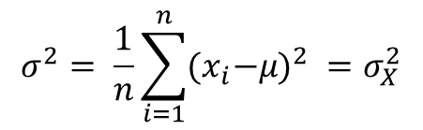
Maximum Likelihood Estimation (MLE)
Sample Mean
Sample Variance

Slide 64
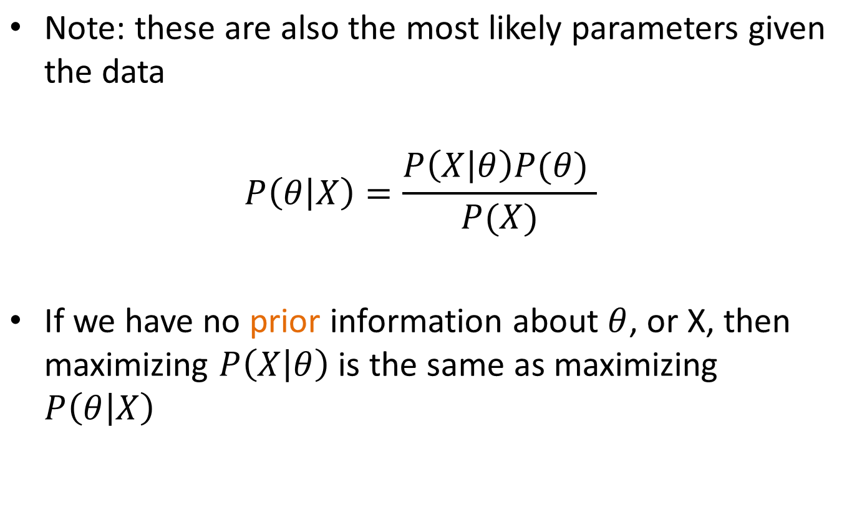
MLE

Slide 65
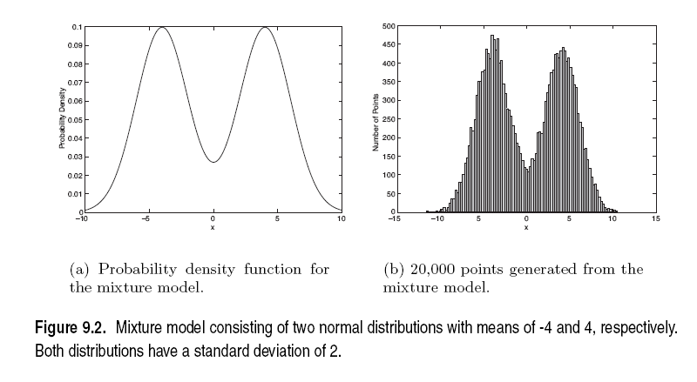
Mixture of Gaussians
Suppose that you have the heights of people from Greece and China and the distribution looks like the figure below (dramatization).

Slide 66
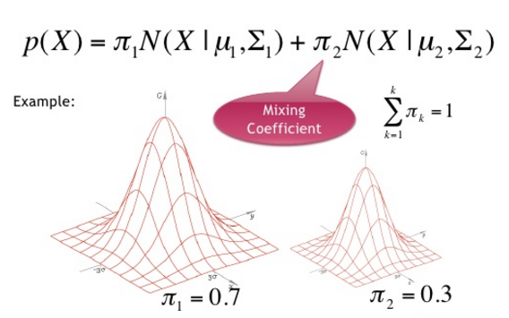
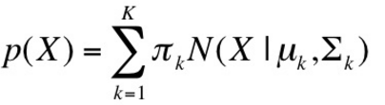
Gaussian Mixture Model

Slide 67
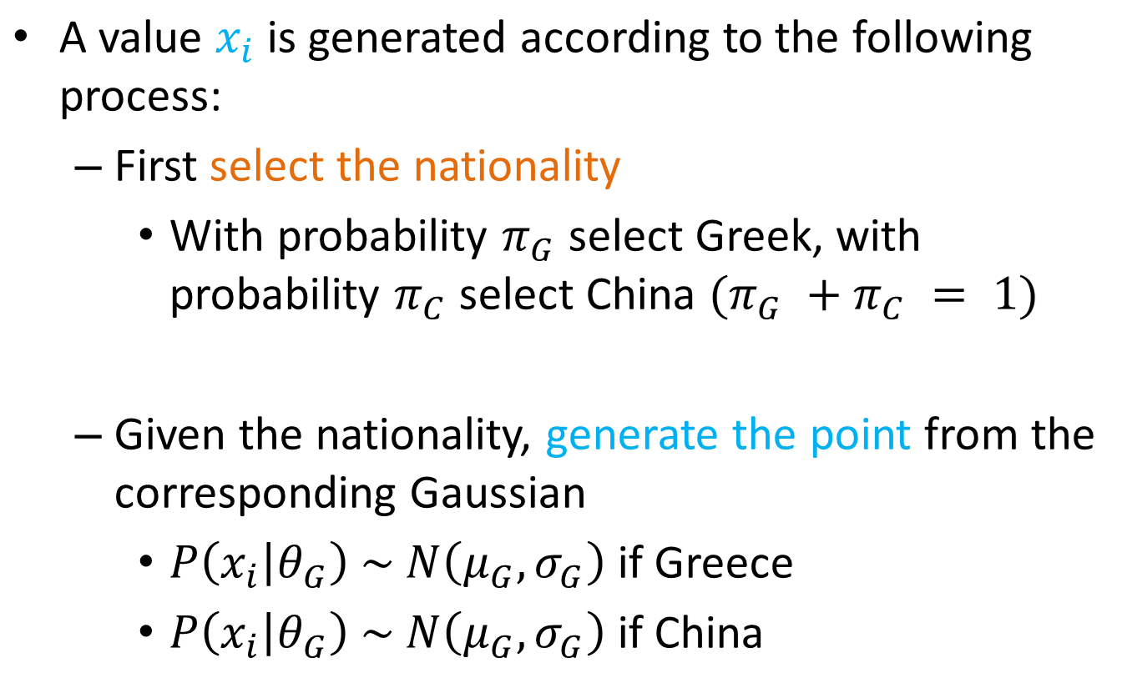
Mixture Model
We can also thing of this as a Hidden Variable Z

Slide 68
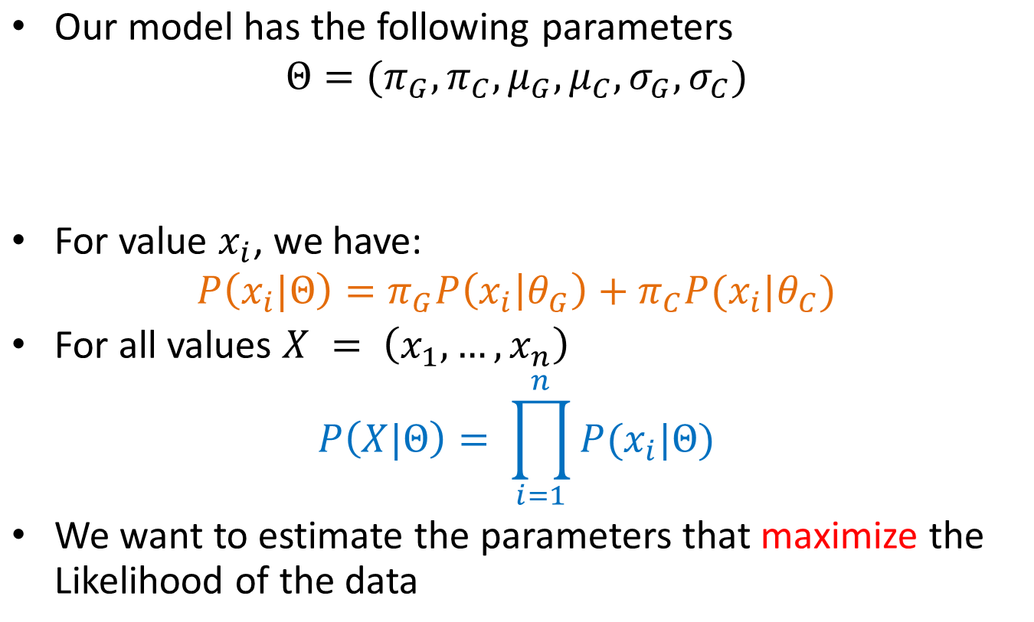
Mixture Model
Mixture probabilities
Distribution Parameters

Slide 69
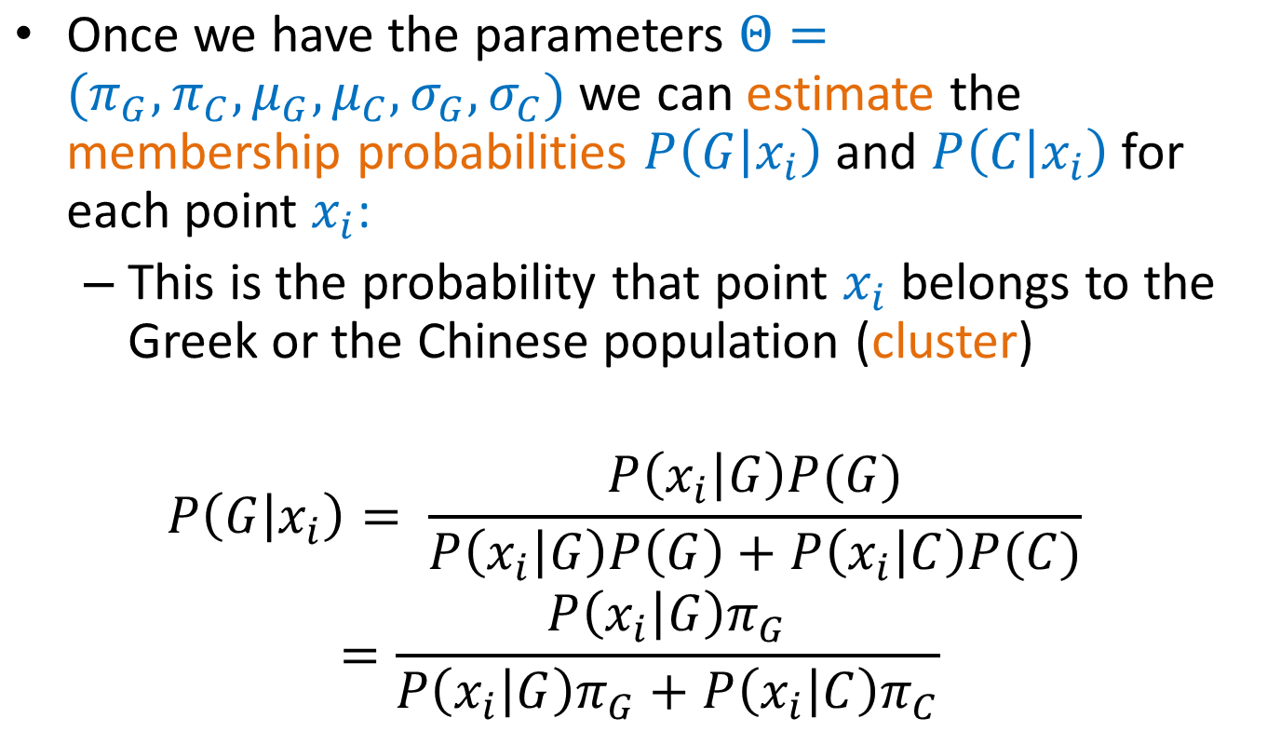
Mixture Models

Slide 70
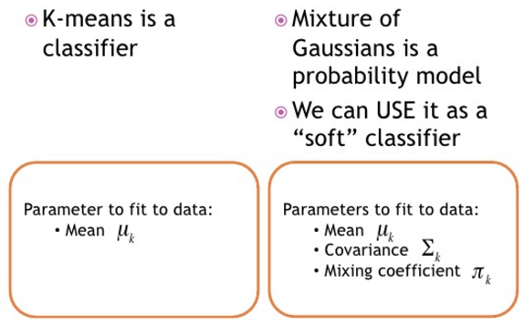
k-Means vs GMM

Slide 71
EXPECTATION-MAXIMIZATION (EM) ALGORITHM

Slide 72
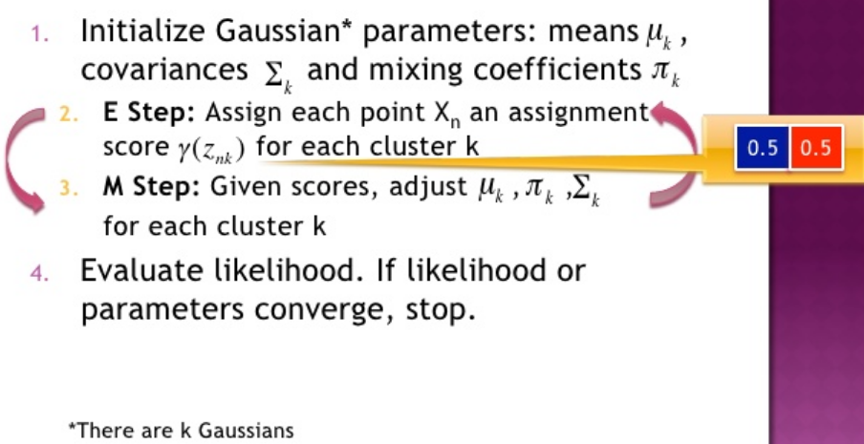
Expectation Maximization (EM) for GMM

Slide 73
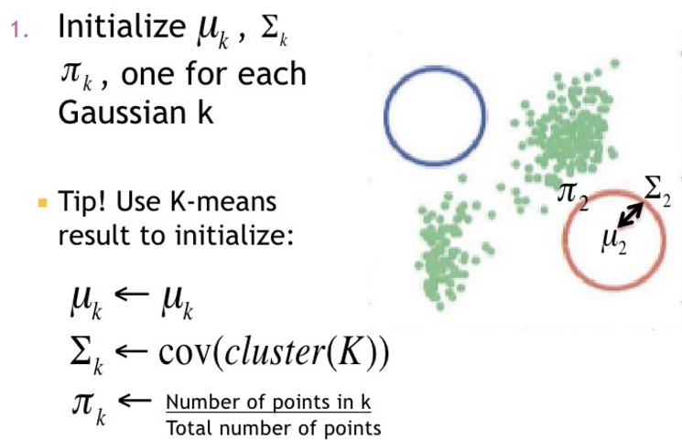
Expectation Maximization for GMM

Slide 74
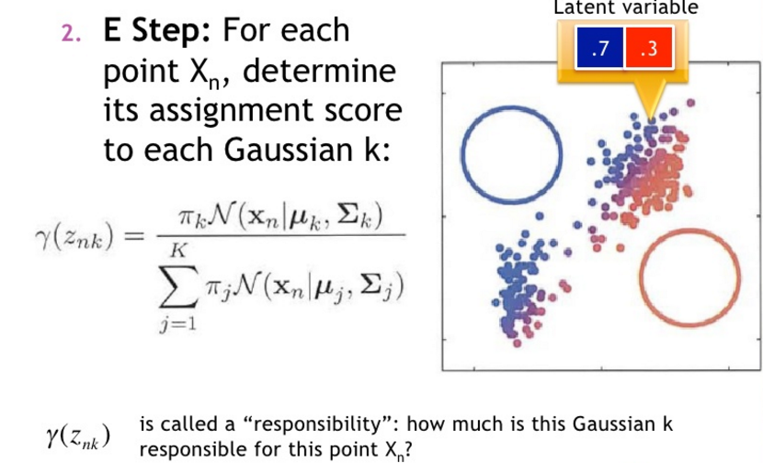
Expectation Maximization for GMM

Slide 75
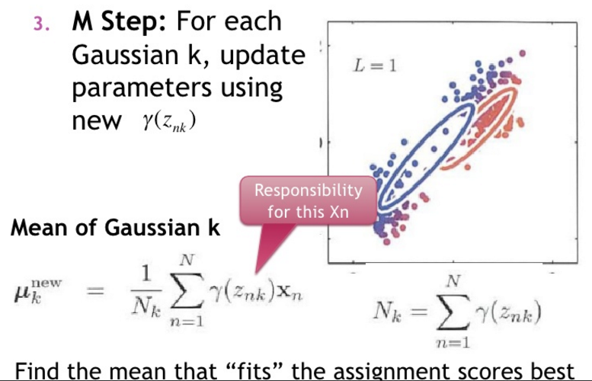
Expectation Maximization for GMM

Slide 76
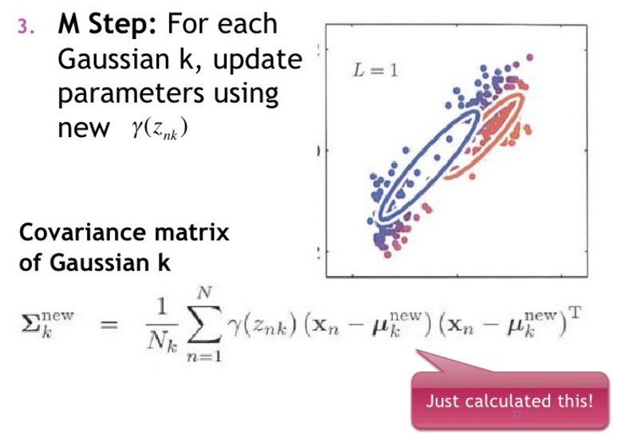
Expectation Maximization for GMM

Slide 77
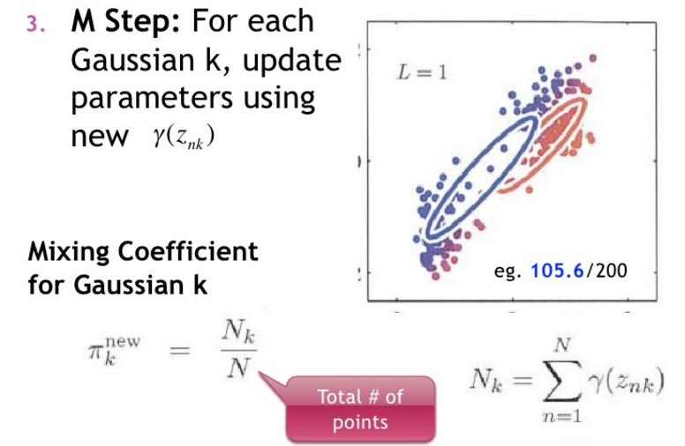
Expectation Maximization for GMM

Slide 78
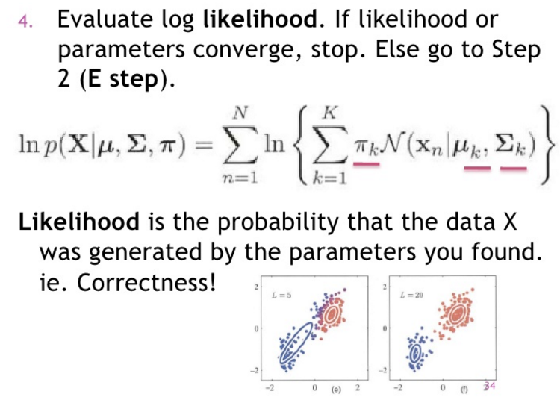
Expectation Maximization for GMM

Slide 79

Expectation Maximization for GMM

Slide 80

Comparison of k-Means and GMM(EM)

Slide 81
Additional References
Han, Kamber, and Pei, Data mining: Concepts and Techniques (3rd edition) http://hanj.cs.illinois.edu/bk3/bk3_slides/03Preprocessing.ppt
Deshpande, 5 situations which drive data pre-processing before data mining (Simafore) http://www.simafore.com/blog/bid/116618/5-situations-which-drive-data-pre-processing-before-data-mining

Slide 82
References
Bishop, C. M. (2006). Pattern recognition and machine learning. springer.
Harrington, P. (2012). Machine learning in action. Manning Publications Co..
Mitchell, Tom M. (1997). Machine learning. McGraw Hill.
Han, Kamber, and Pei, Data mining: Concepts and Techniques (3rd edition) http://hanj.cs.illinois.edu/bk3/bk3_slides/03Preprocessing.ppt
Deshpande, 5 situations which drive data pre-processing before data mining (Simafore) http://www.simafore.com/blog/bid/116618/5-situations-which-drive-data-pre-processing-before-data-mining

Slide 83
Q&A

Slide 84


